Slide 1
Lecture 3
Gauss Elimination With Partial Pivoting

Slide 2
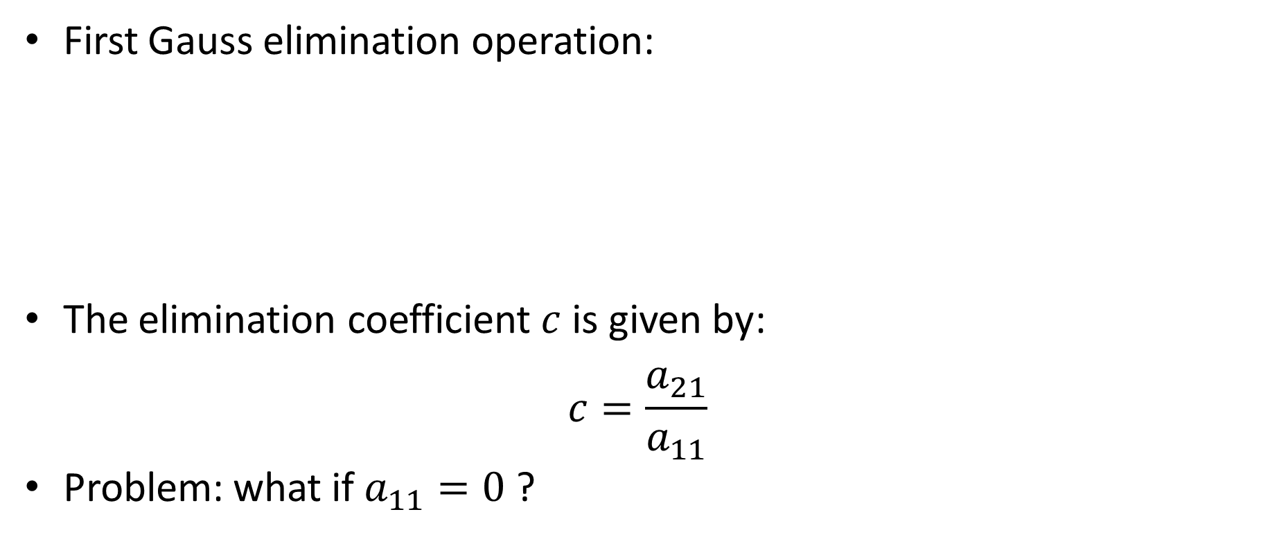


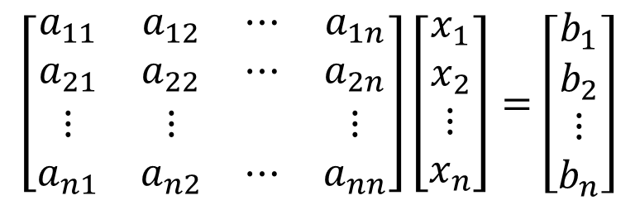
Problem with naive Gauss elimination
First Gauss elimination operation:
The elimination coefficient $c$ is given by:
$$c=\frac{a_{21}}{a_{11}}$$
Problem: what if $a_{11}=0$ ?
$$\left[\begin{matrix}a_{11} & a_{12} & ⋯ & a_{1n} \\ 0 & a_{22}^{′} & ⋯ & a_{2n}^{′} \\ a_{31} & a_{32} & ⋯ & a_{3n} \\ ⋮ & ⋮ & & ⋮ \\ a_{n1} & a_{n2} & ⋯ & a_{nn}\end{matrix}\right]\left[\begin{matrix}x_{1} \\ x_{2} \\ x_{3} \\ ⋮ \\ x_{n}\end{matrix}\right]=\left[\begin{matrix}b_{1} \\ b_{2}^{′} \\ b_{3} \\ ⋮ \\ b_{n}\end{matrix}\right]$$
$$\left[\begin{matrix}a_{11} & a_{12} & ⋯ & a_{1n} \\ a_{21} & a_{22} & ⋯ & a_{2n} \\ ⋮ & ⋮ & & ⋮ \\ a_{n1} & a_{n2} & ⋯ & a_{nn}\end{matrix}\right]\left[\begin{matrix}x_{1} \\ x_{2} \\ ⋮ \\ x_{n}\end{matrix}\right]=\left[\begin{matrix}b_{1} \\ b_{2} \\ ⋮ \\ b_{n}\end{matrix}\right]$$
$$r_{2}←R_{2}−cR_{1}$$
Notes:
In previous lecture we learned how using the naïve Gauss elimination algorithm we can transform a system of equations into an equivalent upper diagonal system.
A typical transformation step is showed on the slide.
For this example the elimination coefficient c is equal to a21/a11.
But what happens if a11 is equal to zero?

Slide 3
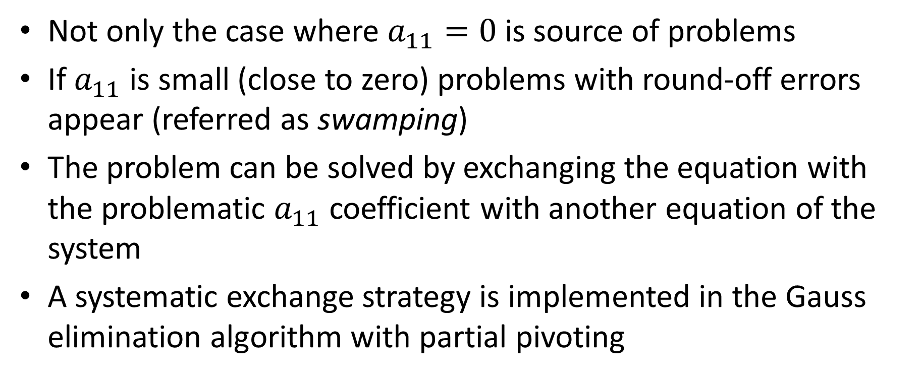
Problem with naive Gauss elimination
Not only the case where $a_{11}=0$ is source of problems
If $a_{11}$ is small (close to zero) problems with round-off errors appear (referred as swamping)
The problem can be solved by exchanging the equation with the problematic $a_{11}$ coefficient with another equation of the system
A systematic exchange strategy is implemented in the Gauss elimination algorithm with partial pivoting
Notes:
In fact not only the case where a11=0 is a problematic situation
If $a_{11}$ is small, problems with round-off errors will appear. In context of linear systems this is referred as swamping
There is however a simple fix to that issue. We can simply exchange the equation with the problematic $a_{11}$ coefficient with another equation of the system
A systematic exchange strategy is implemented in the Gauss elimination algorithm with partial pivoting

Slide 4

Pivoting strategy
Pivoting strategy takes care to exchange the equations such to avoid problems with division by zero or division by small numbers
It scans the column starting from the pivot element downwards and exchanges it with the largest entry in absolute value found
$$\left[\begin{matrix}a_{11} & a_{12} & ⋯ & a_{1n} \\ 0 & a_{22}^{′} & ⋯ & a_{2n}^{′} \\ a_{31} & a_{32} & ⋯ & a_{3n} \\ ⋮ & ⋮ & & ⋮ \\ a_{n1} & a_{n2} & ⋯ & a_{nn}\end{matrix}\right]\left[\begin{matrix}x_{1} \\ x_{2} \\ x_{3} \\ ⋮ \\ x_{n}\end{matrix}\right]=\left[\begin{matrix}b_{1} \\ b_{2}^{′} \\ b_{3} \\ ⋮ \\ b_{n}\end{matrix}\right]$$
Pivot element
Scanned elements
Notes:
The pivoting strategy aims to exchange equations which may lead to problems, either due to division by zero or division by small numbers, by other equations.
The principle is straight forward.
First one identifies the pivot element, as we did for the naïve Gauss elimination algorithm
Then one scans all elements of the column starting from the pivot element downwards.
The aim is to search for the largest element in absolute value.
If the pivot element is already the largest element, nothing needs to be done
Otherwise, one exchanges the equation with the pivot element with the equation containing the largest entry in absolute value.
Let us illustrate this idea with an example.

Slide 5
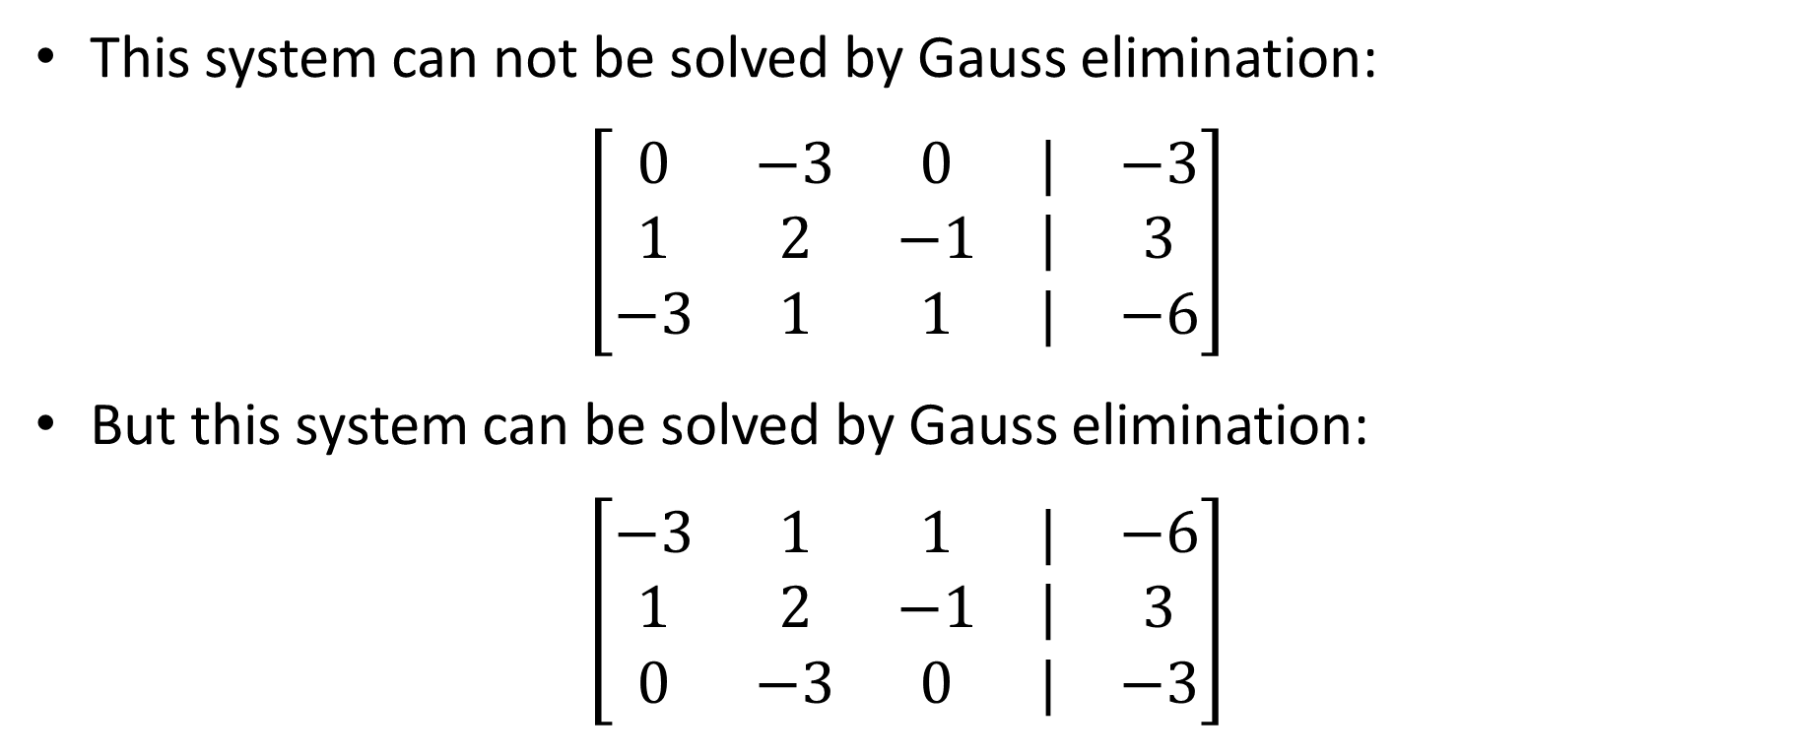
Illustration
This system can not be solved by Gauss elimination:
$$\left[\begin{matrix}0 & −3 & 0 & | & −3 \\ 1 & 2 & −1 & | & 3 \\ −3 & 1 & 1 & | & −6\end{matrix}\right]$$
But this system can be solved by Gauss elimination:
$$\left[\begin{matrix}−3 & 1 & 1 & | & −6 \\ 1 & 2 & −1 & | & 3 \\ 0 & −3 & 0 & | & −3\end{matrix}\right]$$
Notes:
Consider the system of equations displayed
Here our pivot element is equal to zero
Because of this, we cannot apply the Gauss elimination algorithm as it would result into a division by zero
But if we apply our pivoting strategy we will be able to solve the system.
In our case we note that the third equation has the coefficient with the highest value in absolute value.
Consequently we have to swap the first and third equation
The new system can now be solved with Gauss elimination

Slide 6
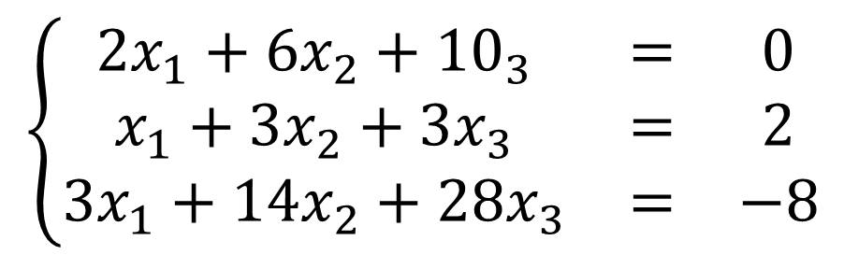

Example
Consider
Augmented matrix notation
$$\left\{\begin{matrix}2x_{1}+{6x}_{2}+{10}_{3} & = & 0 \\ x_{1}+3x_{2}+3x_{3} & = & 2 \\ 3x_{1}+14x_{2}+28x_{3} & = & −8\end{matrix}\right.$$
$$\left[\begin{matrix}2 & 6 & 10 & | & 0 \\ 1 & 3 & 3 & | & 2 \\ 3 & 14 & 28 & | & −8\end{matrix}\right]$$
Notes:
Let us work out a full example.
Consider the system of equation displayed.
First, for more convenience, we write it in augmented matrix form.

Slide 7
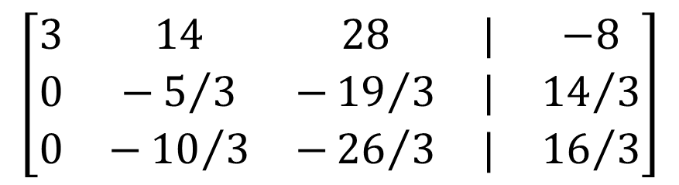

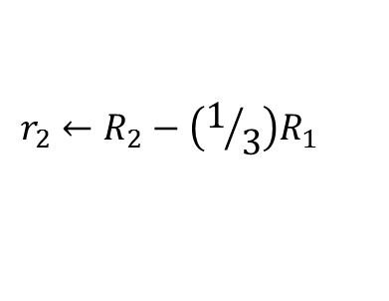
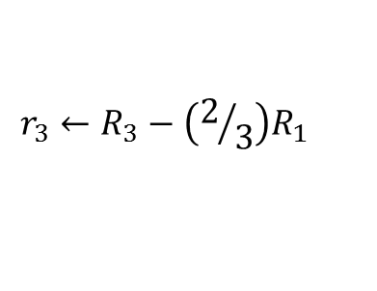


Example
Pivoting strategy
Forward elimination
$$\left[\begin{matrix}2 & 6 & 10 & | & 0 \\ 1 & 3 & 3 & | & 2 \\ 3 & 14 & 28 & | & −8\end{matrix}\right]$$
$$\left[\begin{matrix}3 & 14 & 28 & | & −8 \\ 1 & 3 & 3 & | & 2 \\ 2 & 6 & 10 & | & 0\end{matrix}\right]$$
$$\left[\begin{matrix}3 & 14 & 28 & | & −8 \\ 1 & 3 & 3 & | & 2 \\ 2 & 6 & 10 & | & 0\end{matrix}\right]$$
$$\left[\begin{matrix}3 & 14 & 28 & | & −8 \\ 0 & −5/3 & −{19}/3 & | & {14}/3 \\ 0 & −{10}/3 & −{26}/3 & | & {16}/3\end{matrix}\right]$$
$$r_{2}←R_{2}−\left(1/3\right)R_{1}$$
$$r_{3}←R_{3}−\left(2/3\right)R_{1}$$
Notes:
Let us now apply the pivoting strategy
Our first pivot element is the top left entry of the matrix. In the present case 2.
Now we scan all the elements of the first column starting from the pivot element.
We note that in our example the number 3 is larger than 2. Consequently we exchange these two equations.
We obtain a new equivalent system of equations where equation number one and number 3 were exchanged.
Let us now proceed with the Gauss elimination with this new system of equation.
First we identify the needed row operations
Then we execute the identified operations to obtain our new set of equations

Slide 8
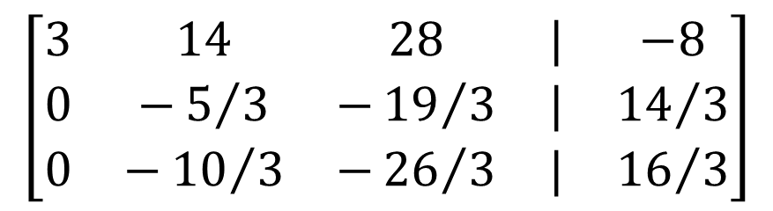
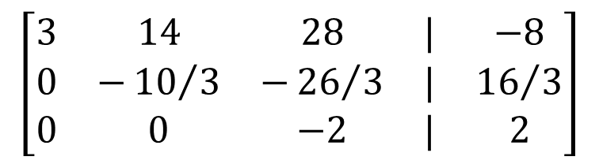
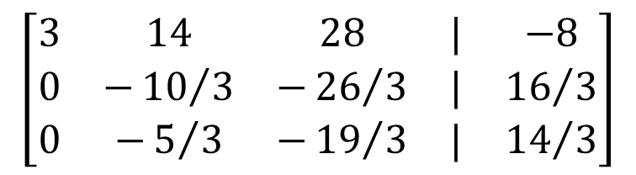
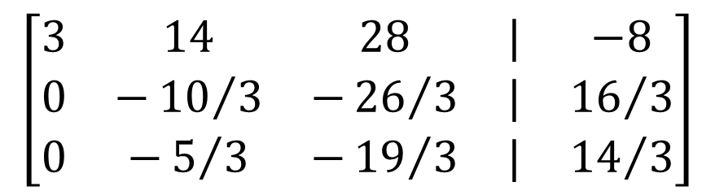
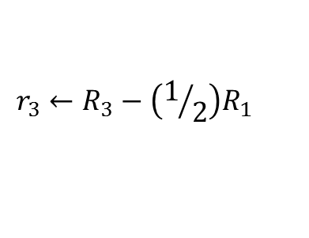
Example
Pivoting strategy
Forward elimination
$$\left[\begin{matrix}3 & 14 & 28 & | & −8 \\ 0 & −5/3 & −{19}/3 & | & {14}/3 \\ 0 & −{10}/3 & −{26}/3 & | & {16}/3\end{matrix}\right]$$
$$\left[\begin{matrix}3 & 14 & 28 & | & −8 \\ 0 & −{10}/3 & −{26}/3 & | & {16}/3 \\ 0 & −5/3 & −{19}/3 & | & {14}/3\end{matrix}\right]$$
$$\left[\begin{matrix}3 & 14 & 28 & | & −8 \\ 0 & −{10}/3 & −{26}/3 & | & {16}/3 \\ 0 & −5/3 & −{19}/3 & | & {14}/3\end{matrix}\right]$$
$$\left[\begin{matrix}3 & 14 & 28 & | & −8 \\ 0 & −{10}/3 & −{26}/3 & | & {16}/3 \\ 0 & 0 & −2 & | & 2\end{matrix}\right]$$
$$r_{3}←R_{3}−\left(1/2\right)R_{1}$$
Notes:
To obtain an upper diagonal system one more Gauss elimination step is required.
For this we work on the highlighted sub-system
At first we identify the pivot element
Then we proceed with the scanning.
Recall that we look to the absolute value of the entries.
As 10/3 is larger than 5/3, we have to swap the two equations
This leads us to a new equivalent system.
We finish the algorithm by proceeding with the Gauss elimination the usual way
First we identify the needed row operations to eliminate the second unknown x2
Proceeding with this operation, we obtain our upper diagonal system.

Slide 9
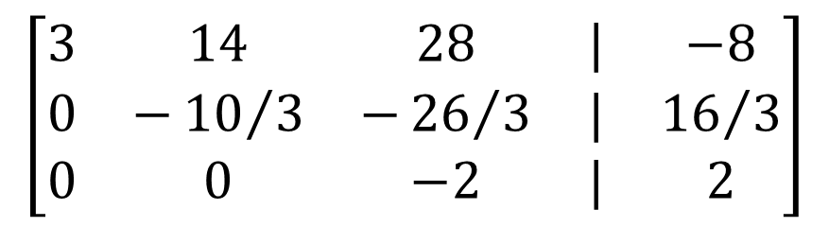

Example
Back substitution
$$\left[\begin{matrix}3 & 14 & 28 & | & −8 \\ 0 & −{10}/3 & −{26}/3 & | & {16}/3 \\ 0 & 0 & −2 & | & 2\end{matrix}\right]$$
$$\underline{x}=\left[\begin{matrix}2 \\ 1 \\ −1\end{matrix}\right]$$
Notes:
Last step that remains to do is to compute the solution of the system using back substitution.

Slide 10
Summary
Naive Gauss elimination with partial pivoting is a systematic strategy to solve systems of linear equations
The pivoting strategy addresses issues for division by zero and division by small numbers
It first transforms the system into a upper diagonal systems by combining pivoting strategy with elimination strategy
And second solves it by back substitution
Notes:
Let us summarize the key findings
Naive Gauss elimination with partial pivoting is a systematic strategy to solve systems of linear equations
The pivoting strategy addresses issues for division by zero and division by small numbers
It first transforms the system into a upper diagonal systems by combining pivoting strategy with elimination strategy
And second solves it by back substitution

